Slide 1




Slide 2

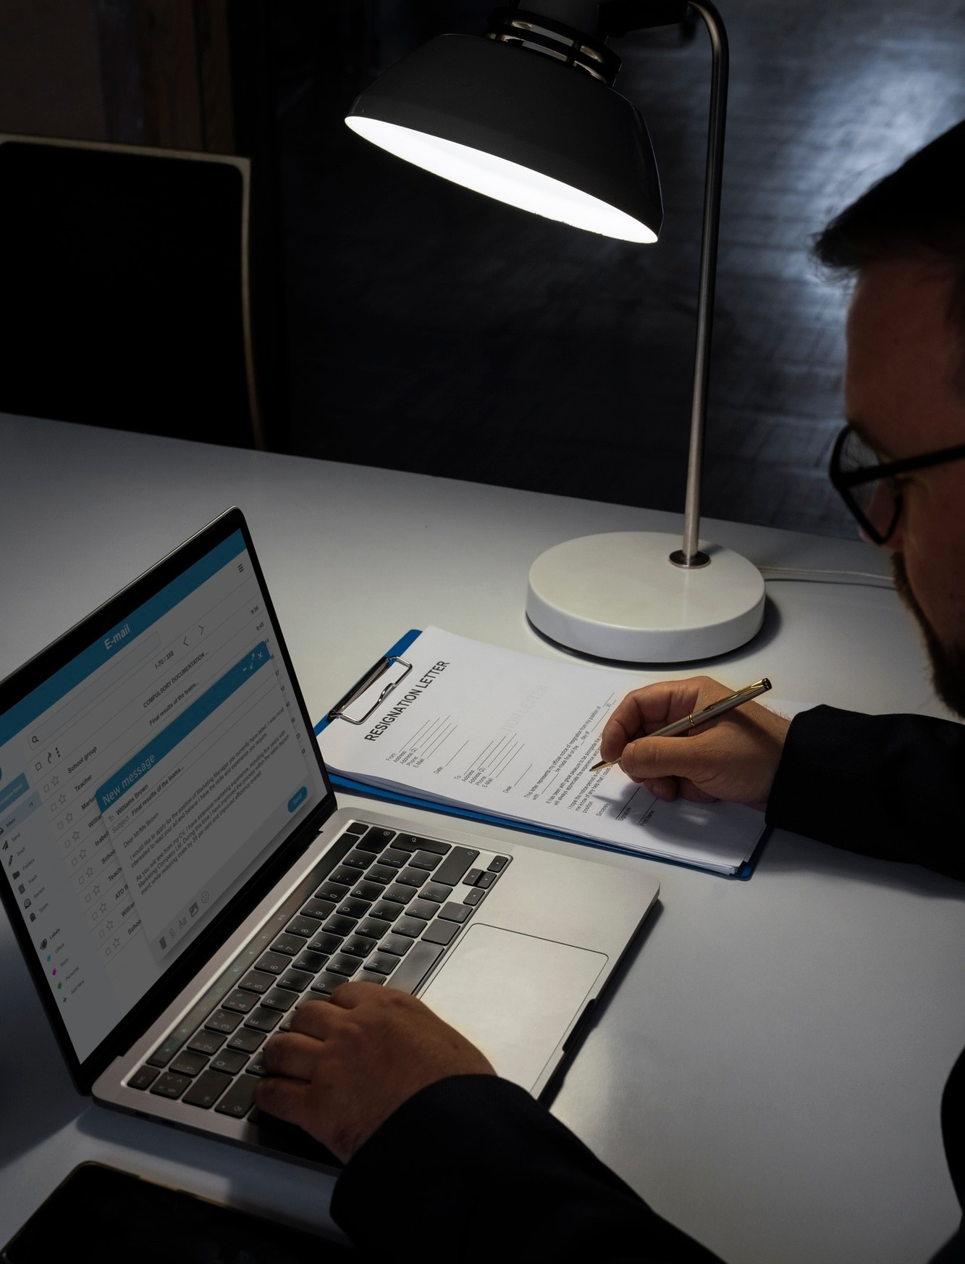
Introduction to My Internship
During my online internship with MLSA, I focused on Full Stack Web Development. This presentation will provide an overview of my key projects, including a Calculator application and a Personal Webpage, highlighting the skills I acquired and the challenges I overcame.

Slide 3

Overview of Full Stack Development
Full Stack Development involves both frontend and backend technologies. I gained hands-on experience in HTML, CSS, and JavaScript for the frontend, while exploring Node.js and Express for backend development. This comprehensive approach allowed me to understand the entire web development process.

Slide 4
Calculator
Project 1: Application
The Calculator Application project aimed to create a user- friendly interface for performing basic arithmetic operations. I utilized JavaScript for functionality and ensured a responsive design using CSS. This
project enhanced
my skills in and user
problem-solving
experience design.

Slide 5

Key Features of the Calculator
Key features of the Calculator include addition, subtraction, multiplication, and division functionalities. Additionally, I implemented error handling to ensure accurate calculations. This project reinforced my understanding of JavaScript and improved my debugging skills.

Slide 6
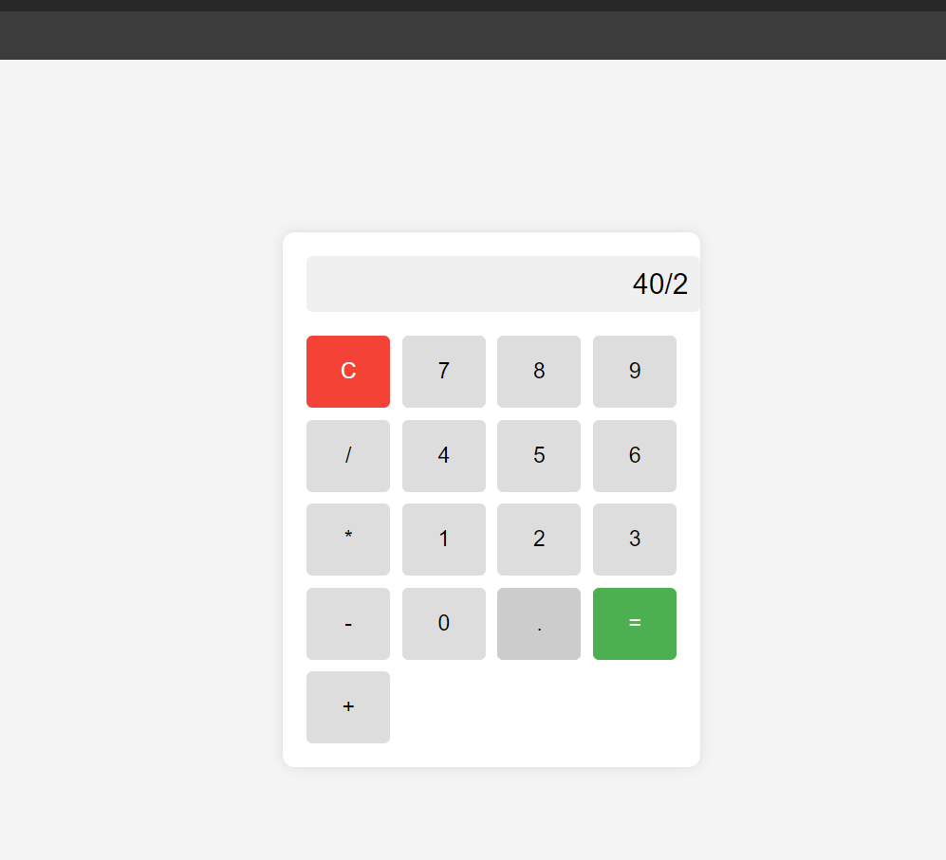
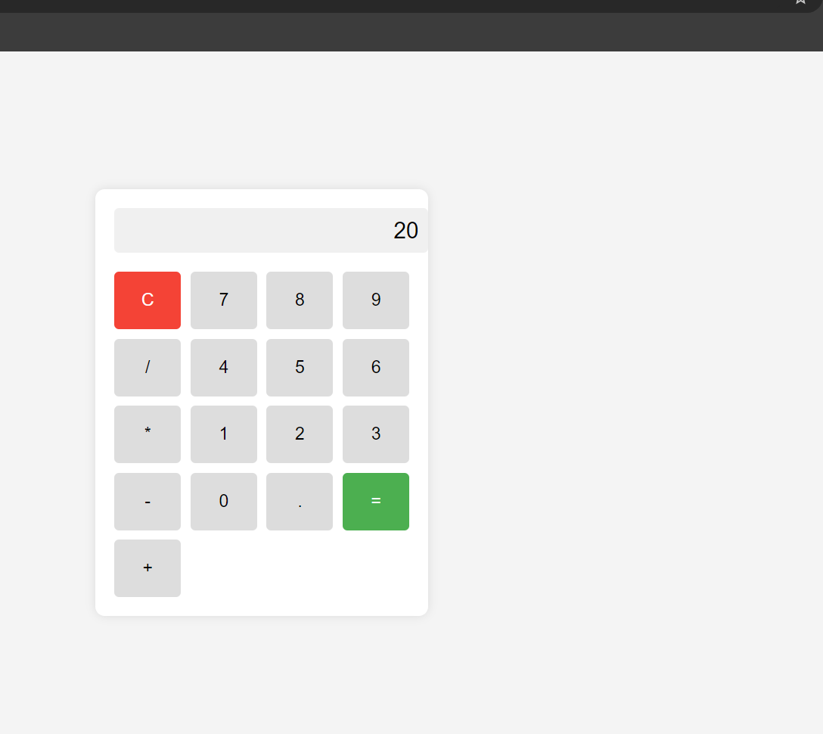

Slide 7
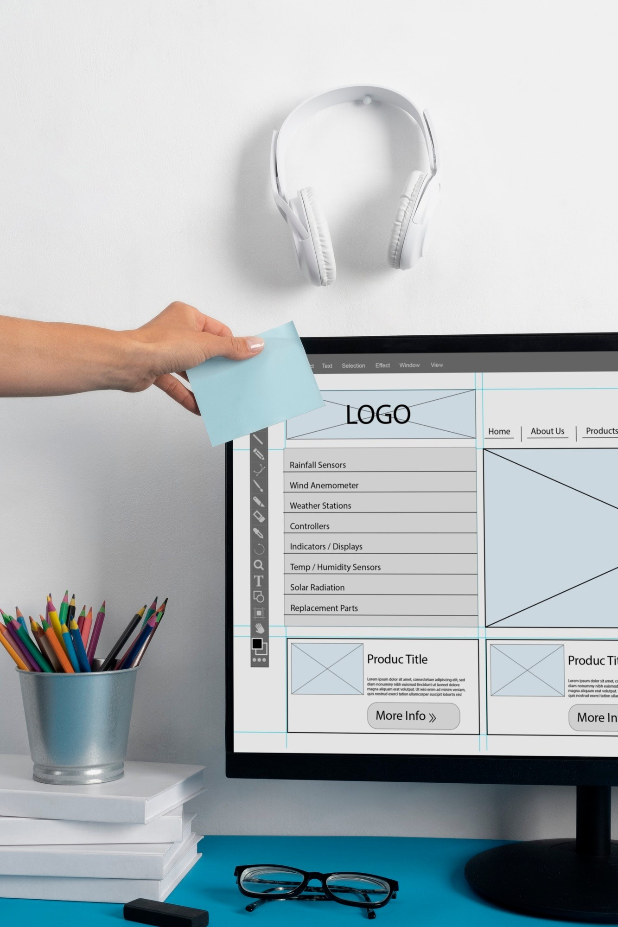
Project 2: Personal Webpage
The Personal Webpage project served as a digital portfolio showcasing my skills and projects. I employed HTML for structure, CSS for styling elements. This project was instrumental in enhancing my web design and content presentation abilities.

Slide 8

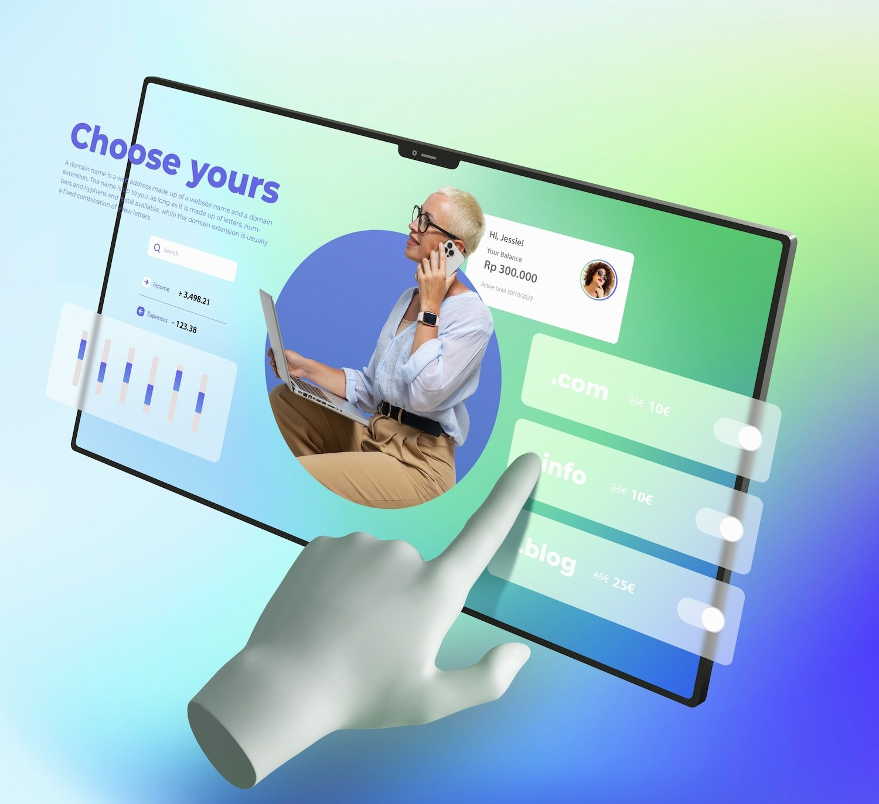
Webpage Design Highlights
The Personal Webpage features a clean layout, easy navigation, and responsive design. I focused on creating a visually appealing interface that reﬂects my personal brand. This project not only improved my design skills but also my understanding of user engagement.

Slide 9
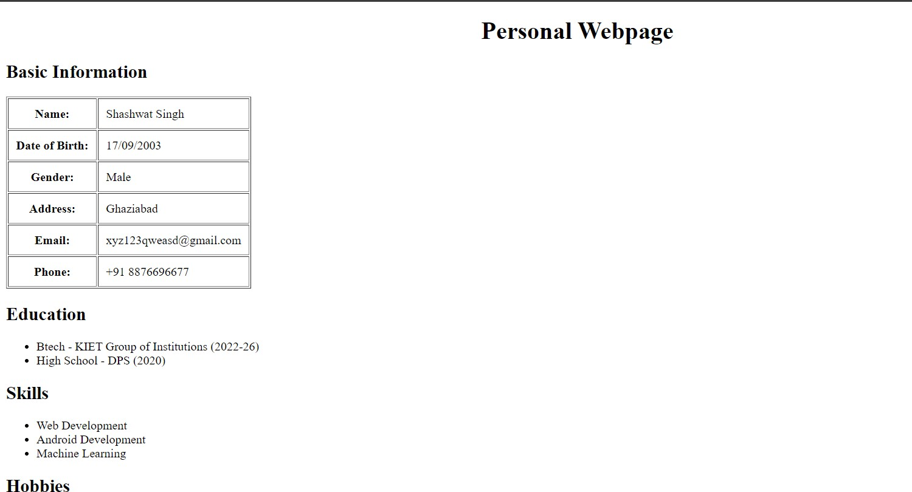

Slide 10

Conclusion and Future Goals
In conclusion, my internship
with MLSA has been a
transformative experience,
enhancing my technical
skills and preparing me for future challenges. I aim to further explore advanced
web technologies
and
contribute to impactful projects in the ﬁeld of web development.

Slide 11

Skills Acquired During Internship
Throughout my internship, I developed a range of skills including frontend and backend development, problem- solving, and project management. I also gained experience in collaborative work and time management, which are crucial in the tech industry.

Slide 12
ou!
Thank You !

